Slide 1
Tools for Building and Execution of Multiscale Applications Marian Bubak AGH Krakow PL and University of Amsterdam NL Grzegorz Dyk and Daniel Harezlak ACC Cyfronet AGH Krakow PL on behalf of the MAPPER Consortium http://www.mapper-project.eu/
3 July 2012
Summer School 2012, MTA SZTAKI, Budapest, HU

Slide 2

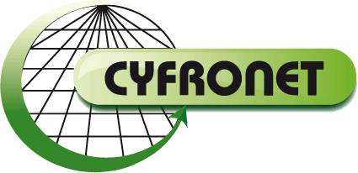


About the speakers
AGH University of Science and Technology (1919)
15 faculties, 36000 students; 4000 employees
http://www.agh.edu.pl/en
1.
Academic Computer Centre
CYFRONET AGH (1973)
120 employees
http://www.cyfronet.pl/en/
Faculty of Electrical Engineering, Automatics, Computer Science and Electronics (1946)
4000 students, 400 employees
http://www.eaie.agh.edu.pl/
Other 14 faculties
Distributed Computing Environments (DICE) Team
http://dice.cyfronet.pl
Department of Computer Science AGH (1980)
800 students, 70 employees
http://www.ki.agh.edu.pl/uk/index.htm
2.
University of Amsterdam, Institute for Informatics, Computational Science
http://www.science.uva.nl/~gvlam/wsvlam

Slide 3
DICE team - http://dice.cyfronet.pl
Main research interests
investigation of methods for building complex scientific collaborative applications and large-scale distributed computing infrastructures
elaboration of environments and tools for e-Science
development of knowledge-based approach to services, components, and their semantic composition and integration
CrossGrid | 2002-2005 | interactive compute- and data-intensive applications
K-Wf Grid | 2004-2007 | knowledge-based composition of grid workflow applications
CoreGRID | 2004-2008 | problem solving environments, programming models
GREDIA | 2006-2009 | grid platform for media and banking applications
ViroLab | 2006-2009 | GridSpace virtual laboratory
PL-Grid; + | 2009-2015 | advanced virtual laboratory
gSLM | 2010-2012 | service level management for grid and clouds
UrbanFlood | 2009-2012 | Common Information Space for Early Warning Systems
MAPPER VPH-Share Collage | 2010-2013 2011-2015 2011-? | computational strategies, software and services for distributed multiscale simulations Federating cloud resources for development and execution of VPH computationally and data intensive applications Executable Papers; 1st award of Elsevier Competition at ICCS2011

Slide 4
Plan
Motivation: multiscale applications
Multiscale modeling
Objectives of the MAPPER project
Programming and execution tools
Infrastructure for multiscale simulations
Demo of tools for an irrigation canals application
Summary

Slide 5
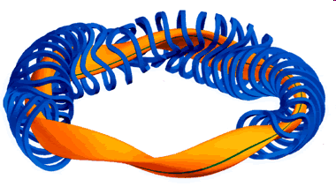
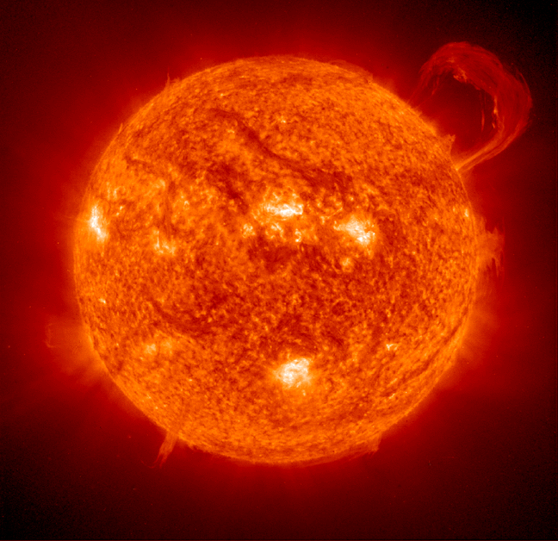
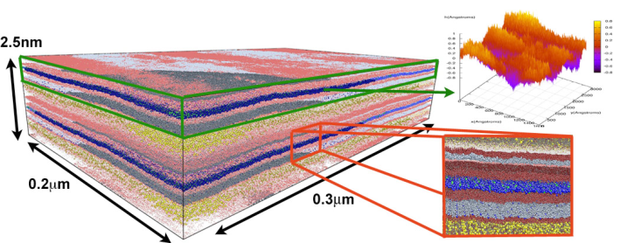
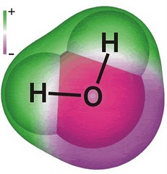
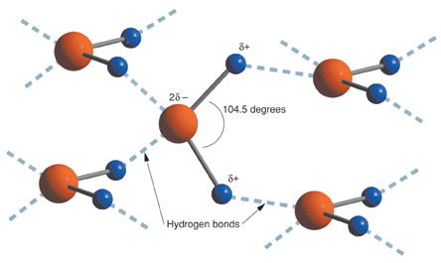
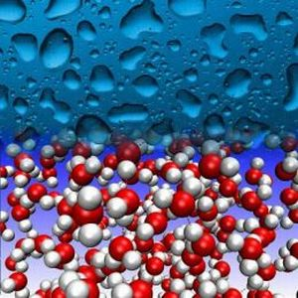
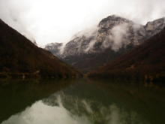
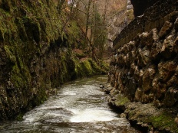
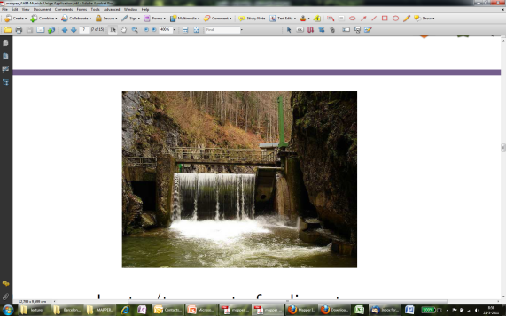
Multiscale everywhere
Natural processes are multiscale
1 H₂O molecule
A large collection of H₂O molecules, forming H-bonds
A fluid called water, and, in solid form, ice.

Slide 6
Why multiscale models?
There is simply no hope to computationally track complex natural processes at their finest spatio-temporal scales even with the ongoing growth in computational power
Minimal requirement:

Slide 7
From multiscale to single scale
spatial
scale
Identify the relevant scales on the scale separation map
Design specific models which solve each scale
Assess errors of a method
Couple the subsystems using an appropriate method
L
Δx
Δt
T
temporal
scale

Slide 8
Multiscale computing
Inherently hybrid models are best serviced by different types of computing environments
Simulations in three dimensions require large scale computing capabilities.
Such large scale hybrid models require a distributed computing ecosystem, where parts of the multiscale model are executed on the most appropriate computing resource.
➔ Distributed Multiscale Computing

Slide 9
Two paradigms
Loosely Coupled
One single scale model provides input to another
Single scale models are executed once
Workflow like
Tightly Coupled
Single scale models call each other in an iterative loop
Single scale models may execute many times
Dedicated coupling libraries are needed
spatial
scale
spatial
scale
L
L
Δx
Δx
Δt
T
temporal
scale
Δt
T
temporal
scale

Slide 10
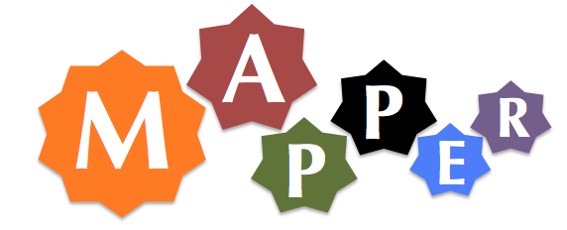









MAPPER
Multiscale APPlications on European e-infRastructures
University of Amsterdam
Poznan Supercomputing and Networking Centre
Akademia Gorniczo-Hutnicza im. Stanislawa Staszica w Krakowie
Chalmers Tekniska Högskola
Max-Planck Gesellschaft zur Foerderung der Wissenschaften E.V.
University College London
University of Ulster
University of Geneva
Ludwig-Maximilians-Universität München

Slide 11


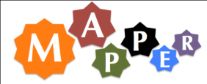


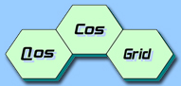

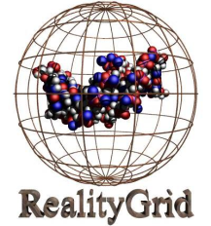
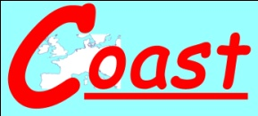

Motivation: user needs
Fusion
VPH
Material Science
Computional Biology
Engineering
Distributed Multiscale Computing Needs

Slide 12
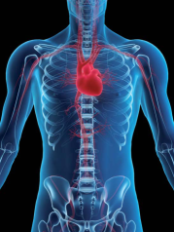
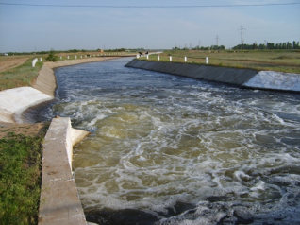
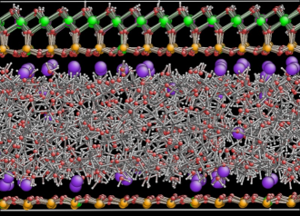
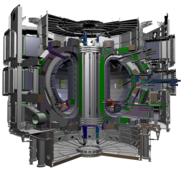
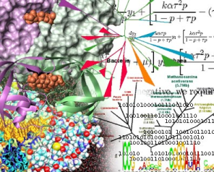
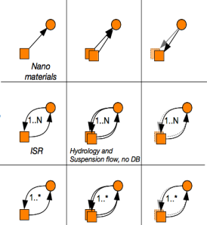
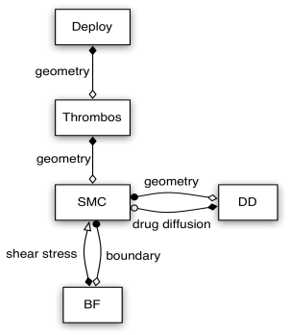
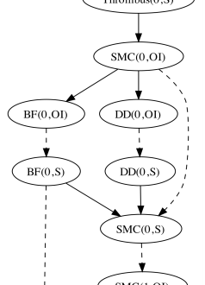
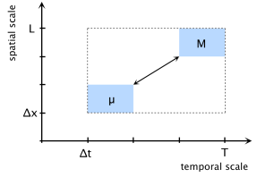
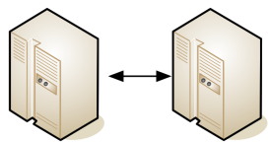
Applications
virtual physiological human
hydrology
nano material science
fusion
computational biology
7 applications from 5 scientific domains ...
... in a common generic multiscale computing framework
SSM Coupling topology (x)MML Task graph Scheduling

Slide 13
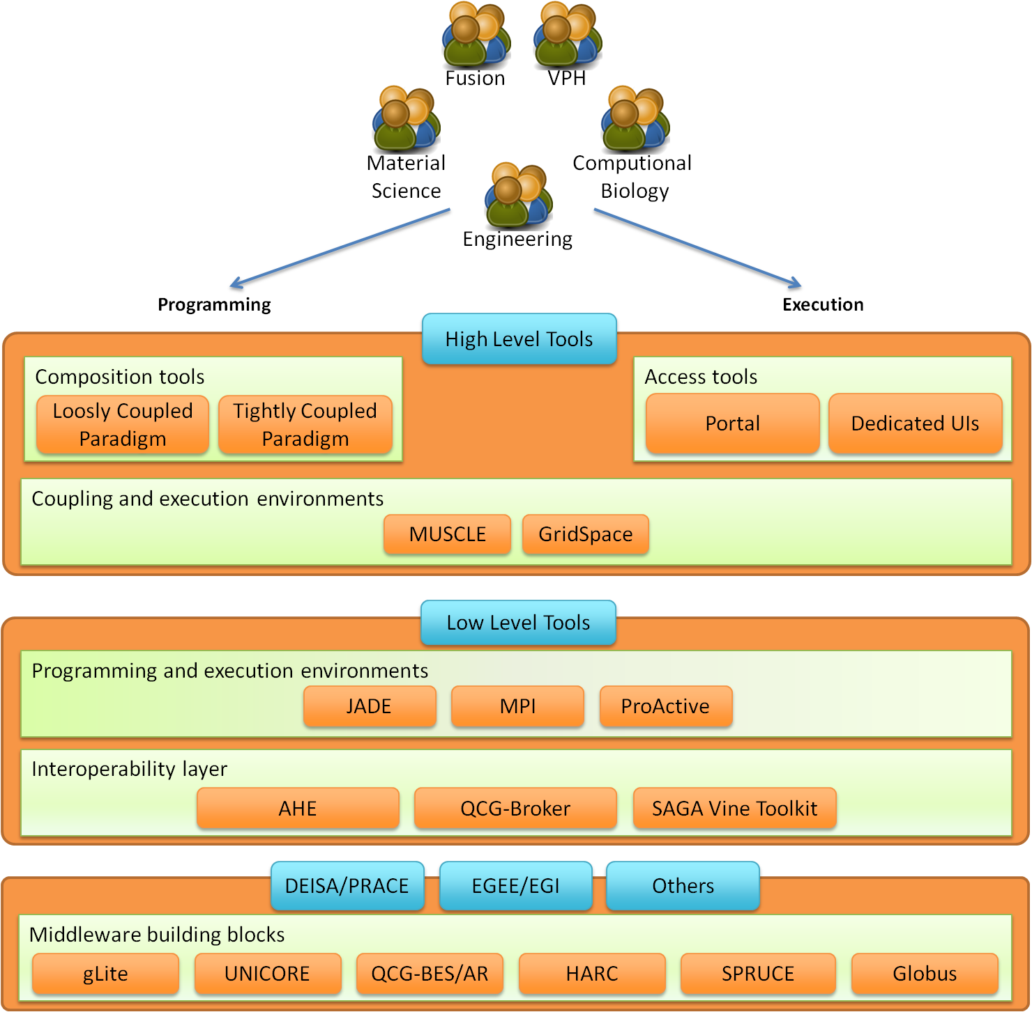
MAPPER main objectives
Develop computational strategies, software and services
for distributed multiscale simulations across disciplines
exploiting existing and evolving European e-infrastructure
Deploy a computational science infrastructure
Deliver high quality components
aiming at large-scale, heterogeneous, high performance multi-disciplinary multiscale computing.
Advance state-of-the-art in high performance computing on e-infrastructures
enable distributed execution of multiscale models across e-Infrastructures,

Slide 14
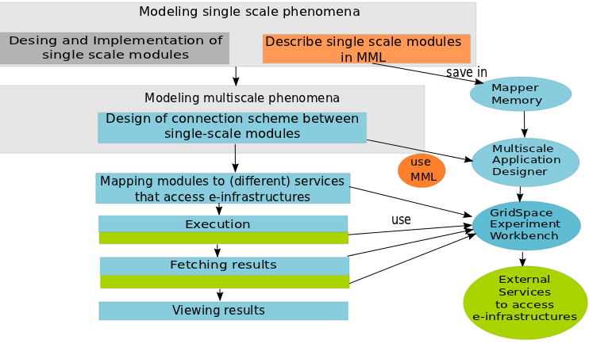
Multiscale application life cycle
Steps
Register single-scale modules in a memory
Design an application
Execute application in distributed environment
View results and provenence
Support
Multiscale Description Language MML (orange)
Programming and execution tools (blue)
Services accessing e-infrastructure (green)

Slide 15
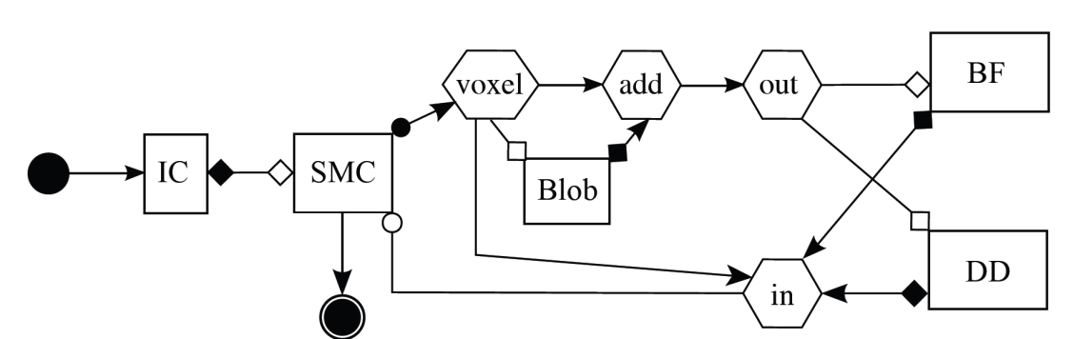
Multiscale modeling language
Uniformly describes multiscale models and their computational implementation on abstract level
Two representations: graphical (gMML), textual (xMML)
Includes description of
scale submodules
scaleless submodules (so called mappers and filters)
ports and their operators (for indicating type of connections between modules)
coupling topology
implementation
Submodel execution loop in pseudocode
f := finit /*initialization*/
t := 0
while not EC(f, t):
Oi(f, t) /*intermediate observation*/
f := S(f, t) /*solving step*/
t += theta(f)
end
Of(f, t) /*final observation*/
Corresponding symbols in gMML
Of
finit
Oi
S
undefined
Example for Instent Restenosis application
IC – initial conditions
DD- drug diffusion
BF – blood flow
SMC – smooth muscle cells

Slide 16
Programming and execution tools
MAPPER Memory (MaMe) a semantics-aware persistence store to record metadata about models and scales
Multiscale Application Designer (MAD) visual composition tool transforming high level MML description into executable experiment
GridSpace Experiment Workbench (EW) execution and result management on e-infrastructures via interoperability layers
Provenance – recording, storing and querying provenance of experiment results

Slide 17
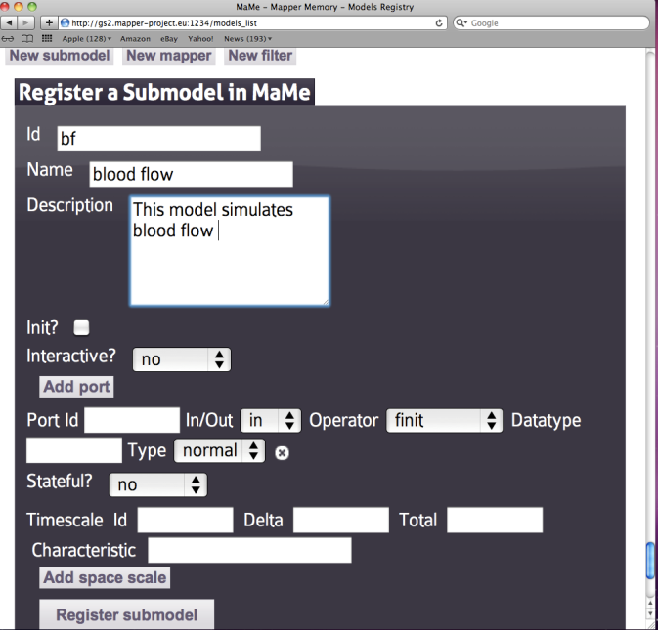
Mapper Memory (MaMe)
Semantics-aware persistence store
Records MML-based metadata about models and scales
Supports exchanging and reusing MML metadata for
other MAPPER tools via REST interface
users via dedicated Web interface
Ports and theiroperators

Slide 18
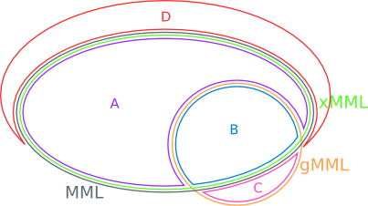
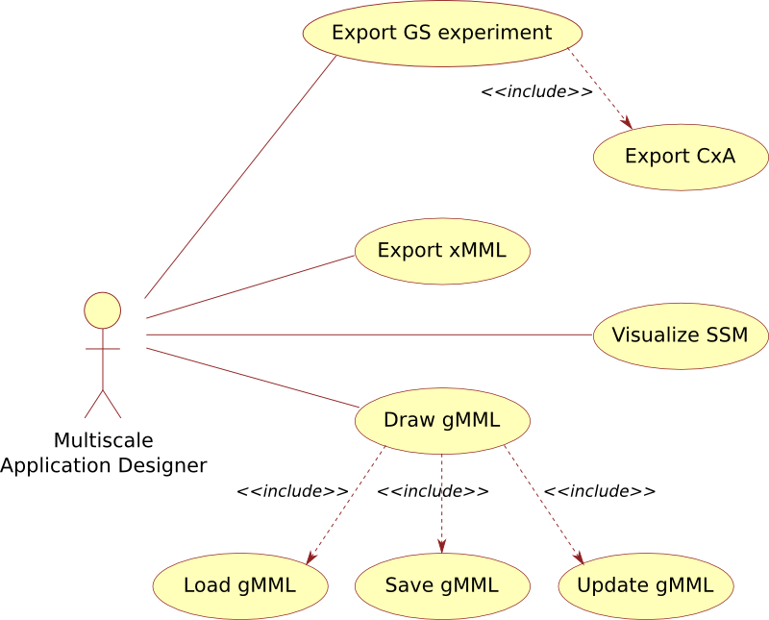
Application Designer (MAD) (1/2)
User friendly visual tool for composing multiscale applications
Supports importing application structure from xMML (section A and B)
Supports composing multiscale applications in gMML (section B) with additional graphical specific information - layout, color etc. (C)
Transforms gMML into xMML
Performs MML analysis to identify its loosely and tightly coupled parts
Using information from MaMe and GridSpace EW, transforms gMML into executable formats with information needed for actual execution (D)
GridSpace Experiment
MUSCLE connection file (cxa.rb)

Slide 19
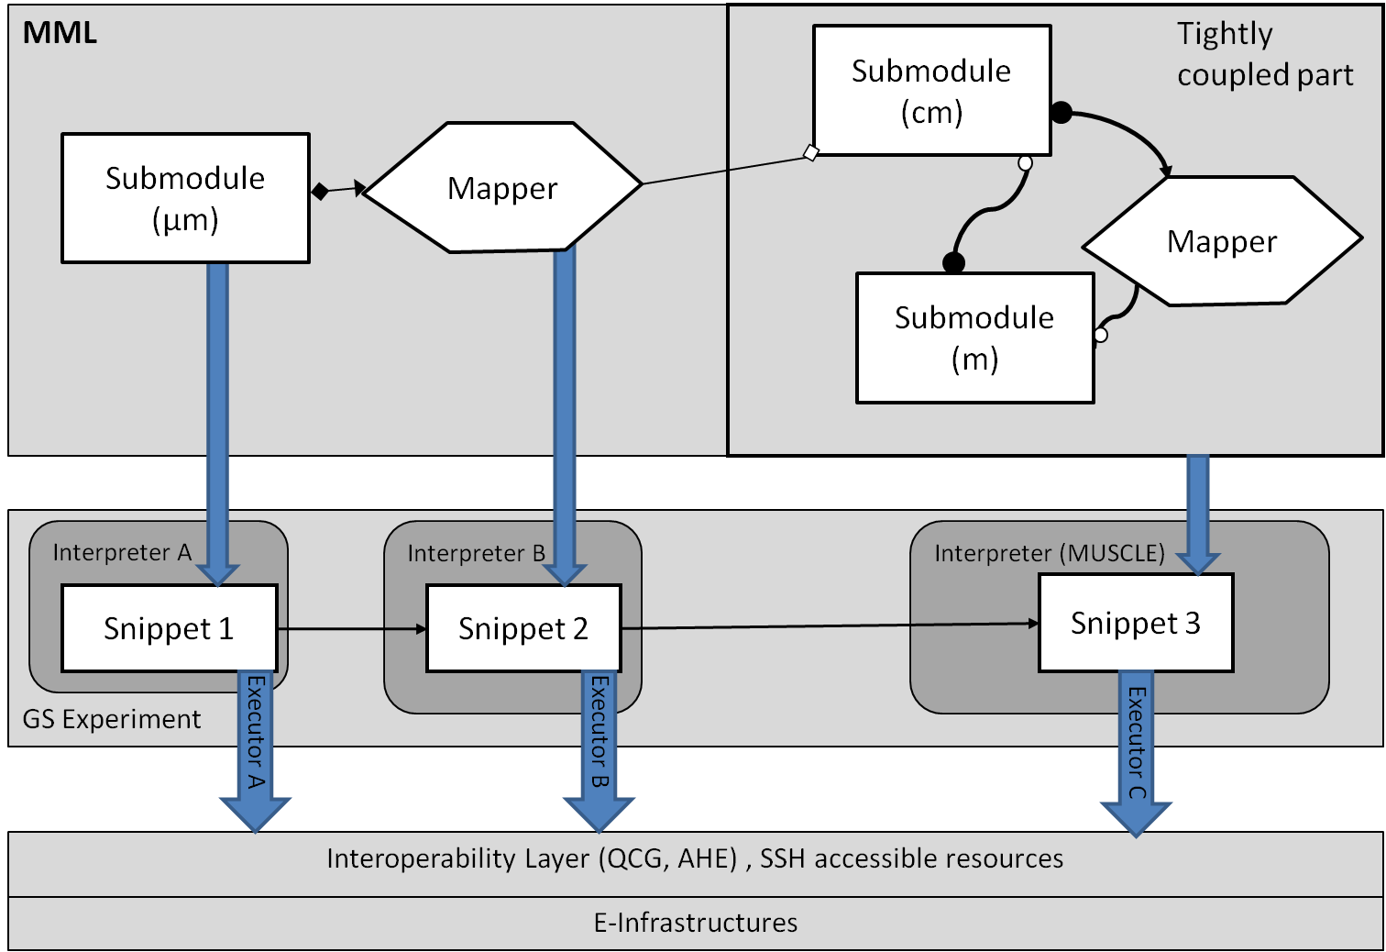
Application Designer (MAD) (2/2)
Supports composing multiscale applications from submodels and mappers registered in MaMe
Inport/export coupling topology represented in gMML to/from XMML file
Transforms high level MML description into executable experiment for GridSpace Experiment Workbench
MAD

Slide 20
GridSpace Workbench
Supports execution and result management of infrastructure independent experiments
Experiment – an application composed of code fragments called snippets, expressed in:
general-purpose scripting programming languages(Bash, Ruby, Perl etc.)
domain-specific languages (CxA in MUSCLE, LAMMPS, Matlab etc)
Snippets are evaluated by respective programs called interpreters
Executors- responsible for snippets execution on computational resources : servers, clusters, grid
direct SSH on UserInterface (UI) machine
Interoperability layer (QCG, AHE)

Slide 21
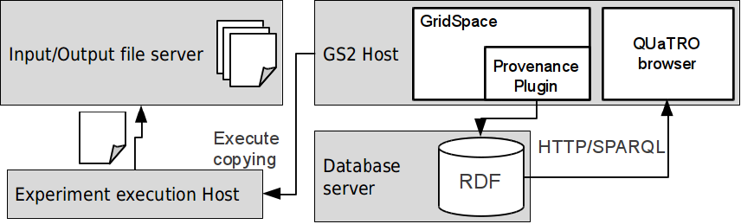
Provenance
Tracing of an experiment start, stop and snippet start/stop events
Provenance data stored in RDF database; OPMV-based ontology
Input/output files of snippets are copied and snapshots are created – experiment result history
Provenance data browser – extensive querying capabilities

Slide 22
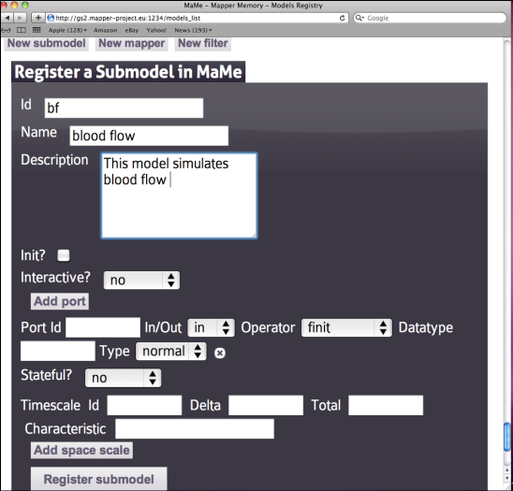
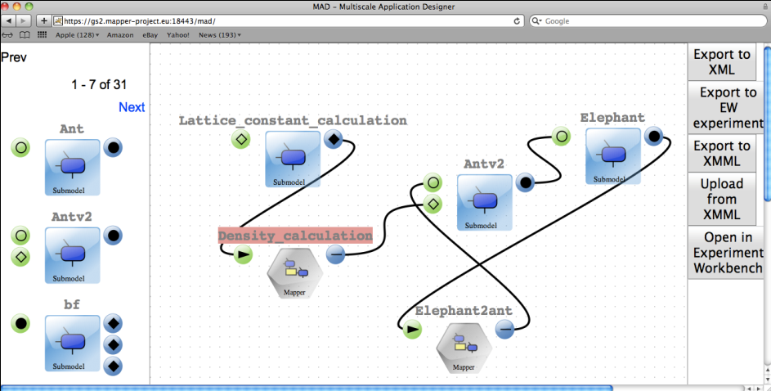
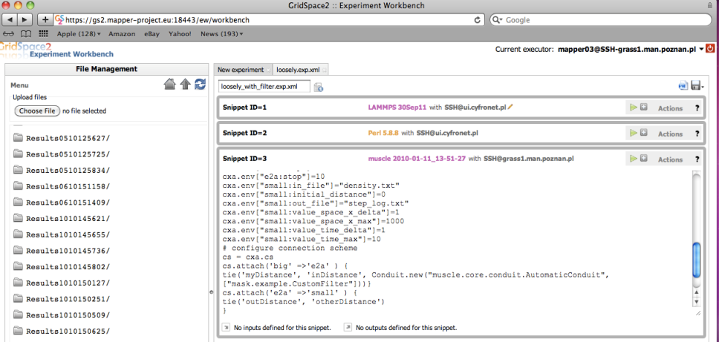
User environment
Registration of MML metadata: submodules and scales
Application composition:
from MML to executable experiment
Execution of experiment using interoperability layer
on e-infrastructure
Result and provenance
Management

Slide 23
E-infrastructure
Joined task force between MAPPER, EGI and PRACE
Collaborate with EGI and PRACE to introduce new capabilities and policies onto e-Infrastructures
Deliver new application tools, problem solving environments and services to meet end-users needs
Work closely with various end-users communities (involved directly in MAPPER) to perform distributed multiscale simulations and complex experiments
Tier - 0
MAPPER Taskforce
1st EU review
selected two apps
on MAPPER
e-Infrastructure
(EGI and PRACE
resources)
Tier - 1
Taskforce
established
MoU signed
1st evaluation
Tier - 2
2011
05
06
08
09
11
2012
2013
…
…

Slide 24
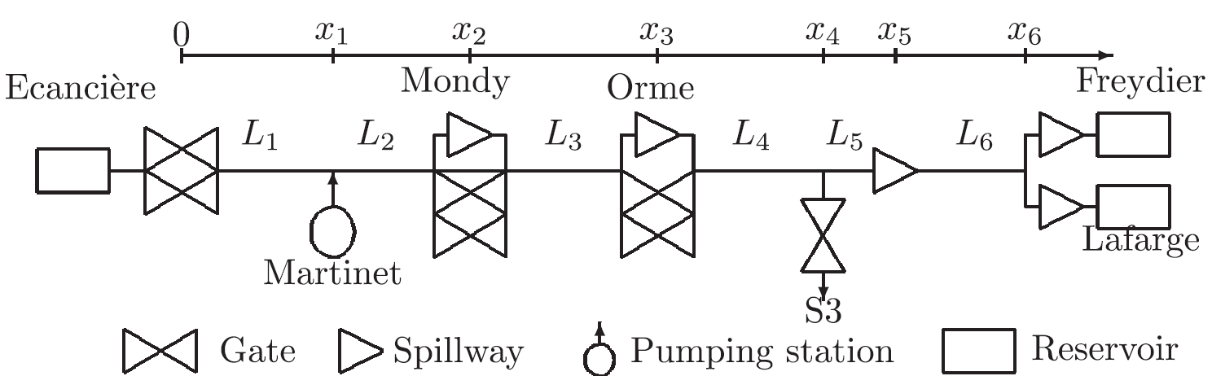
Example: Irrigation canals
Objective
Provide a mutiscale model for the irrigation canal network "La Bourne"
Active control and optimal management
History of the main unusual events / perturbations
Several scenarios in order to find the optimal configuration
Real-time-control and optimization of the water exploitation
Canal network "La Bourne"
15-30 millions m³ of water are distributed to ~9000 clients for a total irrigated area of 10,000 ha, 46 km of length
includes several junctions: tunnels, bridges, spillway, ...etc.

Slide 25


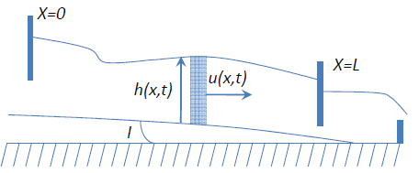
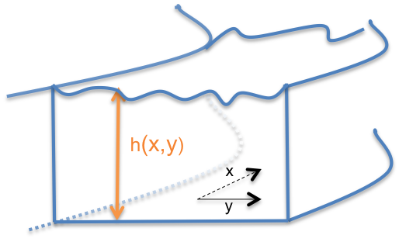

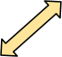
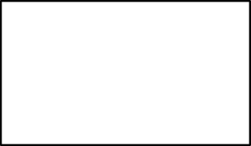
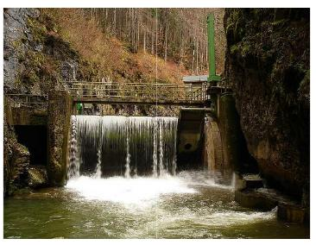
Canals simulation - submodels
CxA coupling
LB models for long canal reaches .
LB-Shallow Water 1D
The water height varies with respect to X and Y.
LB-Shallow water 2D
CxA coupling
CxA coupling
LB-Free Surface 3D
- Flow around gates/transport of sediments
It requires supercomputing capabilities
taken from: Pham van Thang et al. Journal of Computational Physics,229(19) :7373-7400, 2010.

Slide 26
Demos
Canals application life cycle (Daniel)
Provenance at work (Grzegorz)

Slide 27
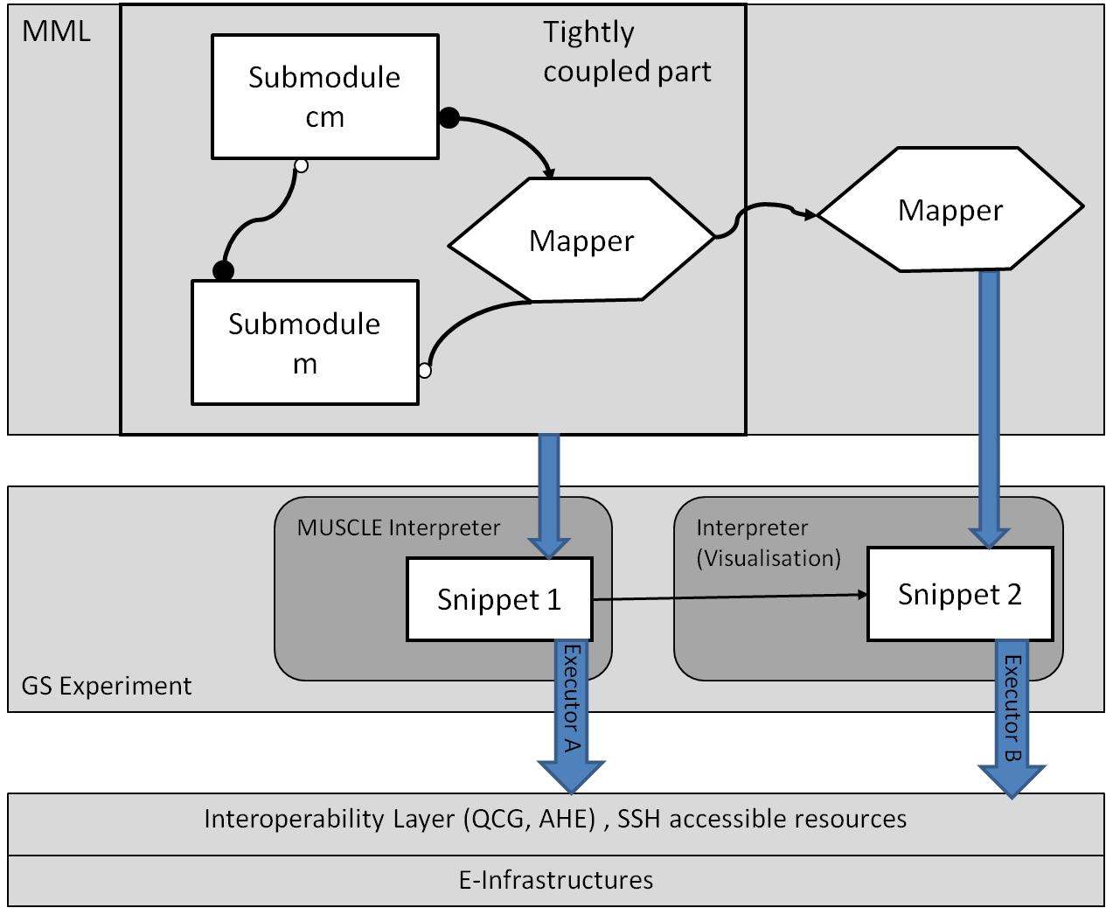
Canal Application
Tightly coupled Java based canal simulation using MUSCLE
Stand-alone canal visualizer and movie maker
# declare kernels which can be launched in the CxA
cxa.add_kernel(’submodel_instance1, ’my.submodelA’)
cxa.add_kernel(’submodel_instance2’, ’my.submodelB’)
…
# configure connection scheme of the CxA
cs = cxa.cs
# configure unidirectional connection betweenkernels
cs.attach ’ submodel_instance1’=> ’submodel_instance2’ do
tie ’portA’, ’portB’
…..
end
…

Slide 28
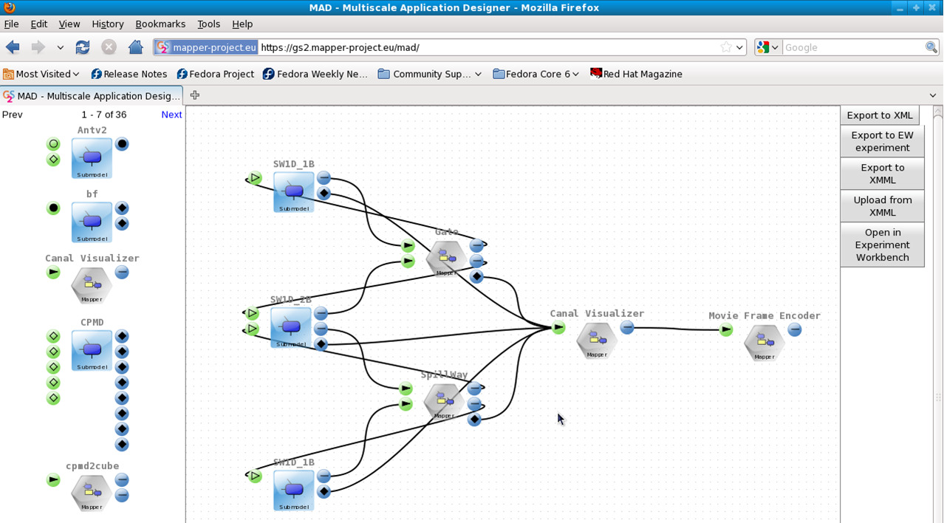
Canal Application MAD

Slide 29
Summary
Elaboration of a concept of an environment supporting developers and users of multiscale applications for grid,HPC and cloud infrastructures
Design of the formalism for describing structures of multiscale applications
Enabling efficient access to e-infrastructures
Validation of the formalism against real applications structure by using tools
Proof of concept for transforming high level formal description to actual execution using e-infrastructures
Notes:
MB - sugestie

Slide 30
More about MAPPER
http://www.mapper-project.eu/
http://dice.cyfronet.pl/

Slide 31
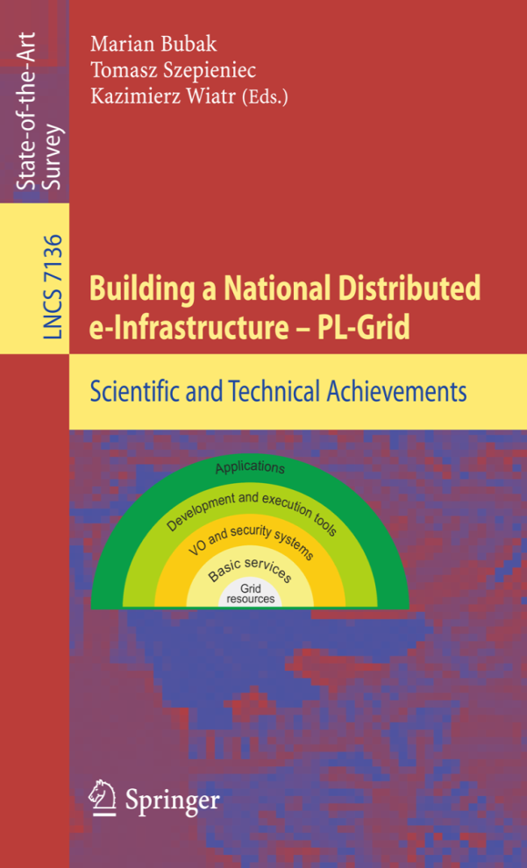
And more at …
dice.cyfronet.pl
www.science.uva.nl/~gvlam/wsvlam
www.plgrid.pl
www.cyfronet.pl/cgw12

